Slide 1
Delaware Education Staffing Levels
By Andrew McLaughlin

Slide 2

Can Delaware’s performance on English assessments improve?
Yes, with proper staffing levels of key positions, Delaware student performance on English assessments can improve.

Slide 3
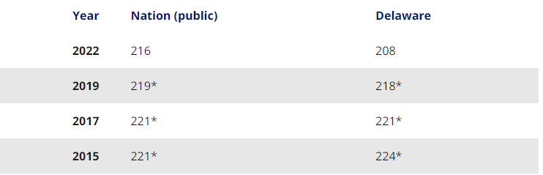
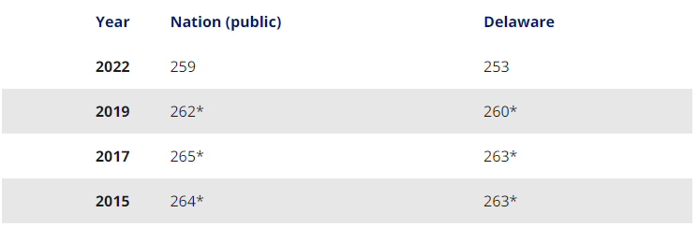
Delaware Sits Below the National Average on Reading Assessments
Delaware 4th Graders sit 8 points below national average according to NAEP testing.
Delaware 8th Graders are 6 points below national average according to NAEP testing.

Slide 4
Delaware DOE does not spend entire Budget on Staff
In the fiscal year 2022, the State of Delaware allocated 1.1 billion dollars to be spent on Personnel costs in the Department of Education.
Close examination of the data reveals that the State spent in fact only 840 million dollars on Personnel costs that year.

Slide 5
Would Scores Improve with more Staff?
With this surplus of over 250 million dollars in the budget, would state reading scores improve if that money was spent on more staff?
Which staff roles in particular should be targeted with increases?

Slide 6
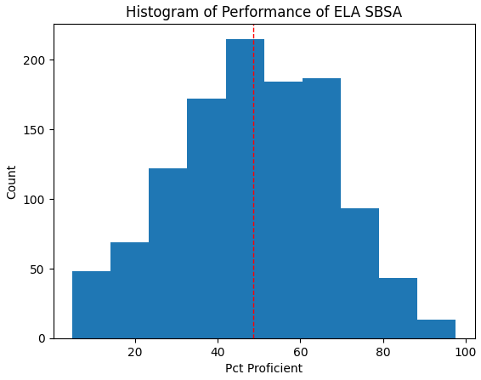
Proficiency Scores on ELA tests are normally distributed.
State schools are normally distributed on performance of the ELA version of the Smarter Balanced Summative Assessment, the most common assessment in the state.
The average schools has 48% of students proficient
The state in general has 41.7% of students proficient

Slide 7
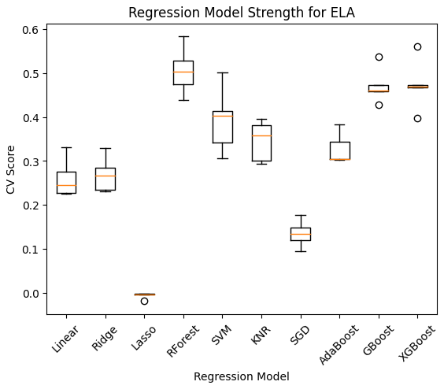
Different Regression Models were tested, XGBoost was Best
XGBoost regressor showed best balance between a high R-score of .6, speedy implementation and an explainable model.

Slide 8
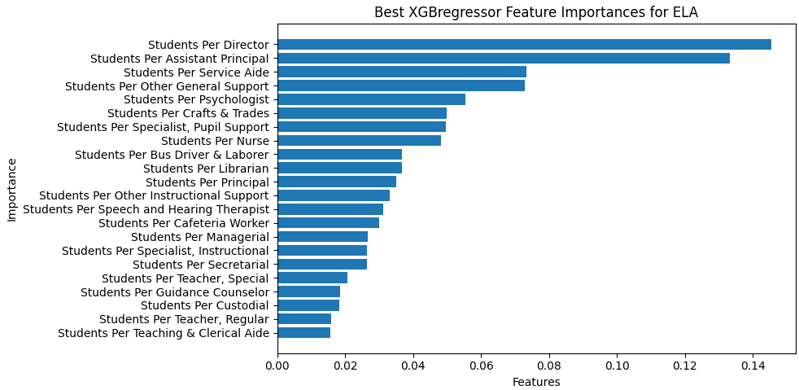
XGBoost model suggests Assistant Principals and Directors are Important
Students Per Director and Students Per Assistant Principal are two most important features when creating the model.

Slide 9

Model Closely Matches State Performance
State of Delaware has 41.7% of students proficient on ELA test.
Model suggests that at current staffing levels state should have 39.4% of students proficient.

Slide 10

Increasing Number of APs improves the model results
An increase in the number of assistant principals in the state by 77 new positions improved model student proficiency from 39.4% to 51.4%

Slide 11
How much would that much staff cost?
At the average assistant principal salary of $110000, it would cost state about 8.6 million dollars to add 77 assistant principals statewide.
This is a mere fraction of the 250 million dollar staffing budget surplus.
Overtime, increasing proficiency by 25% will cause Delaware’s reading scores to match and surpass the national average.

